Slide 1
ARTIFICIAL INTELLIGENCE & MACHINE LEARNING
V.B.S.VEDHA
V.MEGHANA

Slide 2
TOPIC : IMAGE FORGERY DETECTION
ALGORITHM USED :
CONVOLUTIONAL NEURAL NETWORK (CNN)

Slide 3
RESEARCH PAPER :
IEEE 2022 CONFERENCE PAPER
IDENTIFYING FAKE IMAGES THROUGH CNN BASED CLASSIFICATION USING FIDAC
LINK :
https://ieeexplore.ieee.org/stamp/stamp.jsp?tp=&arnumber=9862034

Slide 4
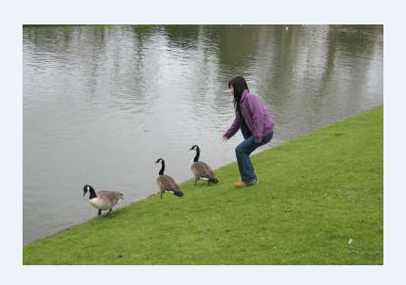
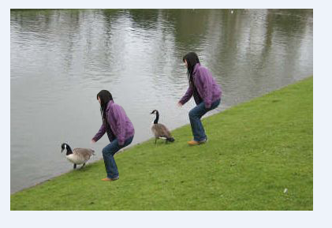
AUTHENTIC VS TAMPERED IMAGES

Slide 5
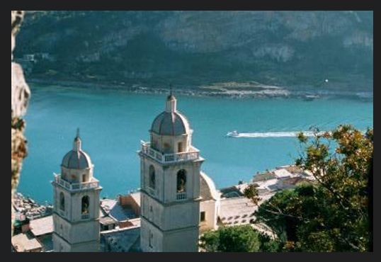
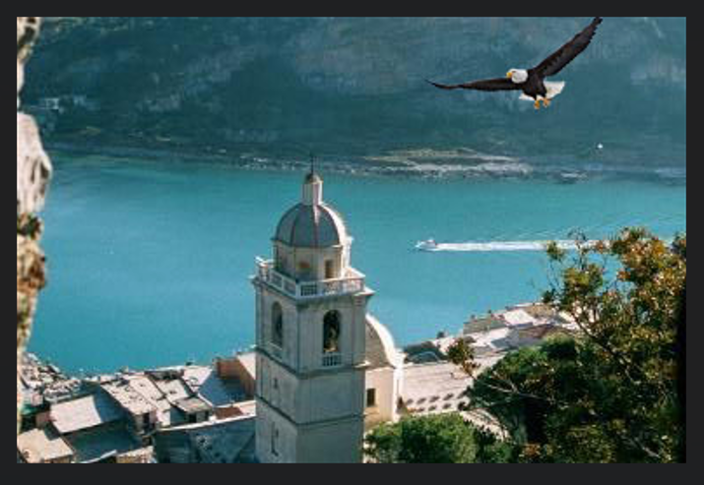

Slide 6
CODE :
https://colab.research.google.com/drive/1CrPlVkPZsKwiY8t8yncSwS0SvivqjZqs?usp=sharing

Slide 7
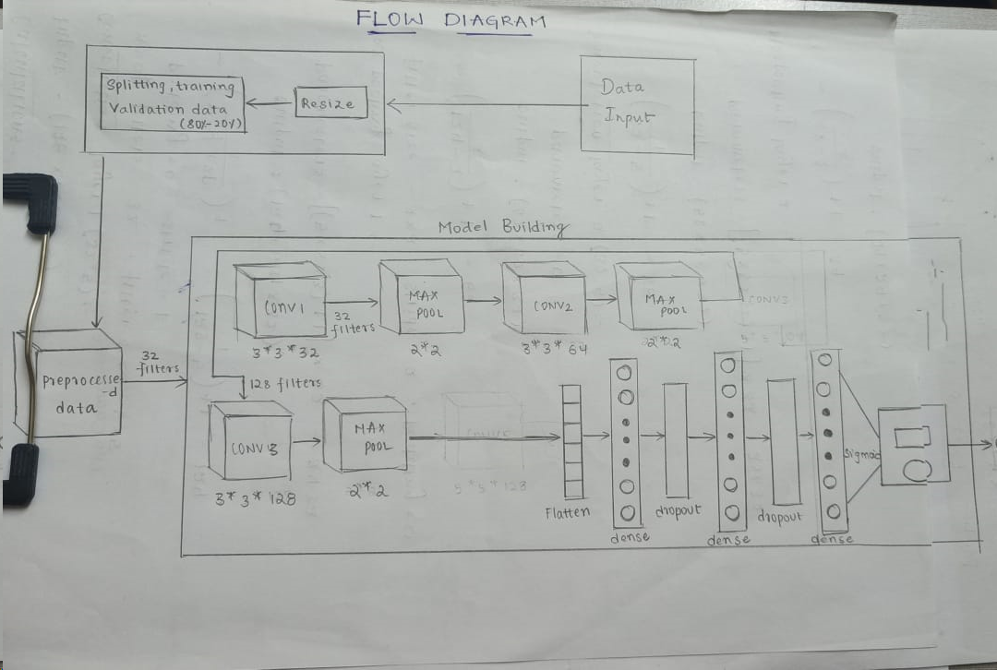
FLOW DIAGRAM :

Slide 8
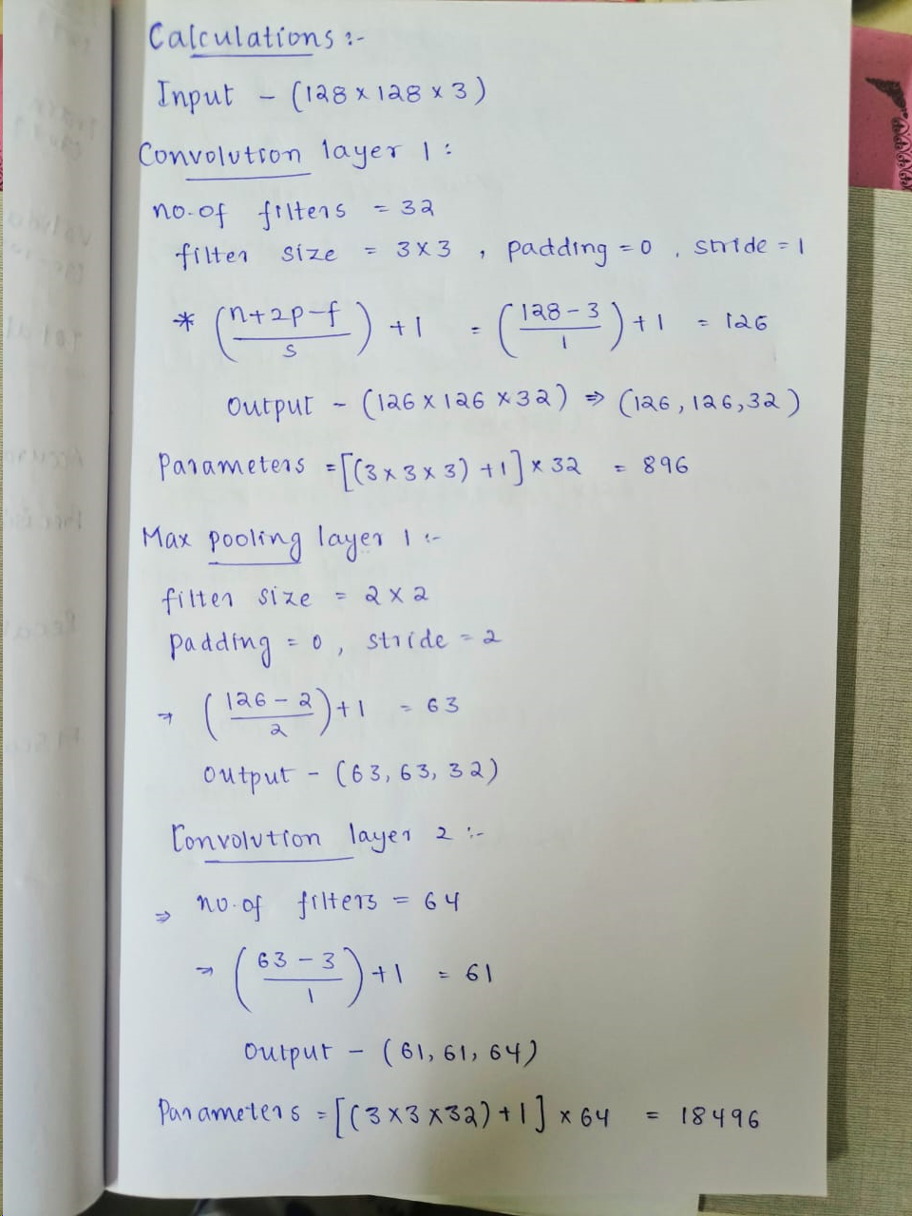
CALCULATIONS

Slide 9
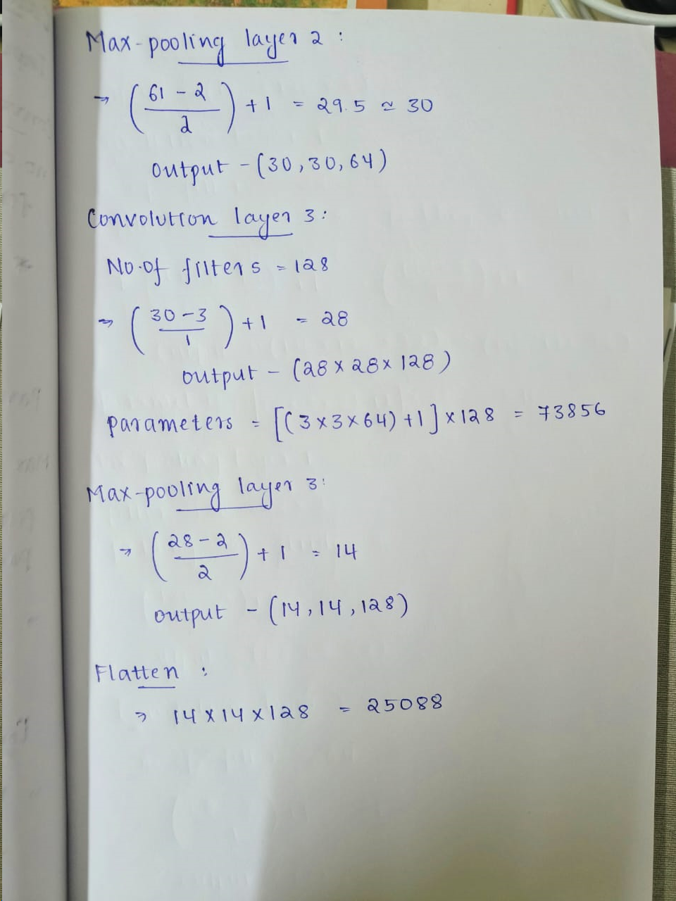

Slide 10
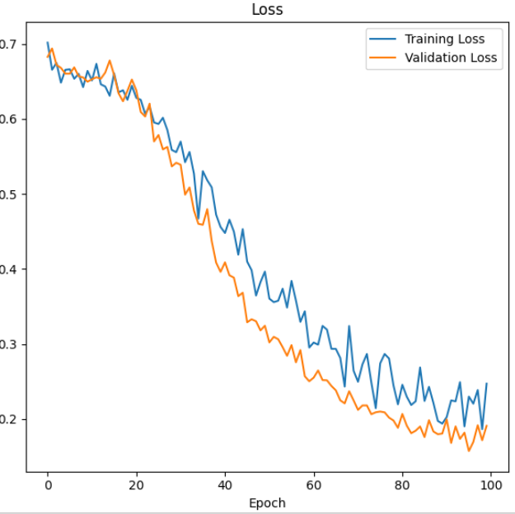
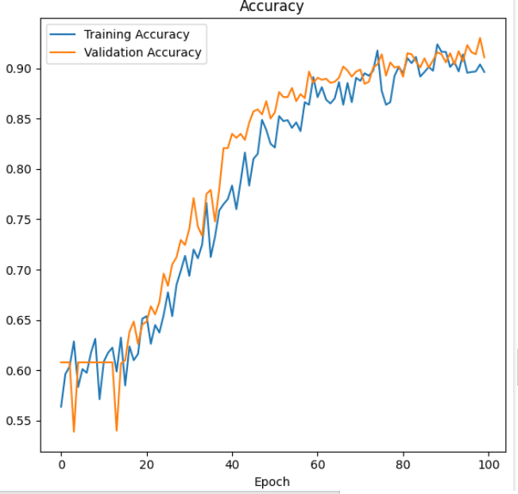
GRAPHS :

Slide 11
APPLICATIONS OF IMAGE FORGERY DETECTION :
AUTHENTICATION AND VERIFICATION
SOCIAL MEDIA CONTENT
INTELLECTUAL PROPERTY PROTECTION
DIGITAL FORENSICS

Slide 12
CONCLUSION :
Thus we Implemented Image Forgery Detection using Convolutional Neural Networks and we got a model with an accuracy of
The accuracy value should not be considered as a final result.
The accuracy received can be further improved by increasing the size of the input dataset and increasing the number of epochs. Also considering better optimizers and augmentation techniques might also give better results.

